Slide 1




Introduction to Data Analysis with Jupyter
Tendai Munyaradzi Marengereke

Slide 2

Who am I ?
Background
Computer Science
Information Security & Cyber Forensics
Work
Lecturer – Information Security & Assurance @ Harare Institute of Technology
Consultant & Researcher – Information Security, Digital Forensics, Computer Science , High Performance Computing, Data Analytics, Machine Learning
Entrepreneur
Likes
Anime – Cowboy Bepob, Samurai Champloo etc
Music – Anything good
Tech/ Geek Stuff
Python enthusiast

Slide 3
What is Data Analysis
Data analysis is a process of inspecting, cleansing, transforming, and modeling data with the goal of :
discovering useful information,
suggesting conclusions
and supporting decision-making.

Slide 4
Digital Forensics
The post – mortem specialist for Cybersecurity
Responsible for after incident evaluation of a target
e.g find evidence after a hacking incident or data breach.

Slide 5
JUPYTER
Jupyter is a language-agnostic app that branched out of ipython (specifically, ipython notebook ).
The jupyter notebook is a generalization of the ipython version…..it is now a web-app that can be used as a notebook for a huge variety of different languages (not just python ).
The Jupyter Notebook is a web application that allows you to create and share documents that contain live code, equations, visualizations and explanatory text.

Slide 6
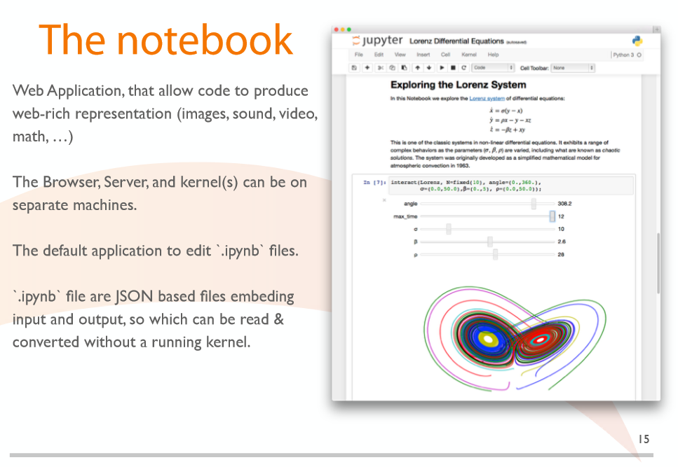
Cont.

Slide 7
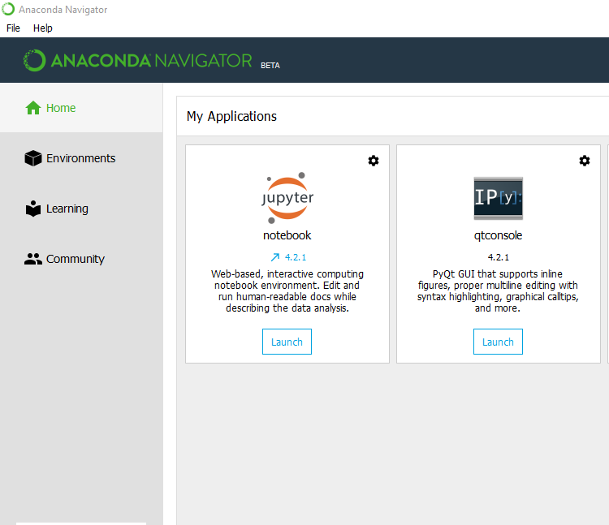
Jupyter – How do you get it?
Easiest way is to install Anaconda Python
Anaconda is the leading modern open source analytics platform powered by Python. Anaconda makes it easy to install and manage packages and environments while achieving scalability and high performance in a collaborative environment.

Slide 8
DEMO

